Slide 1
Quad chart examples

Slide 2
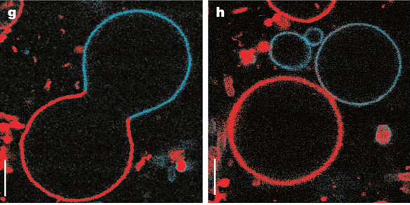
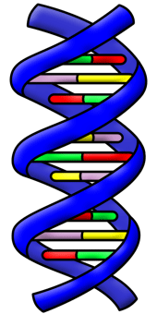
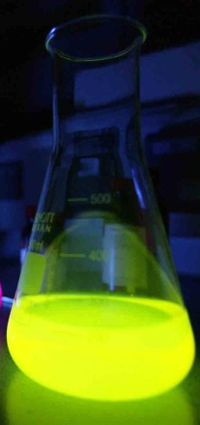
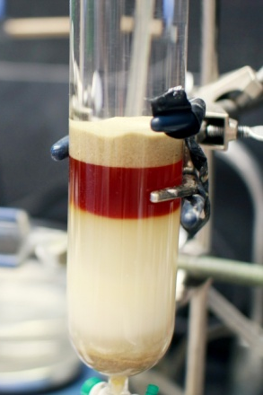
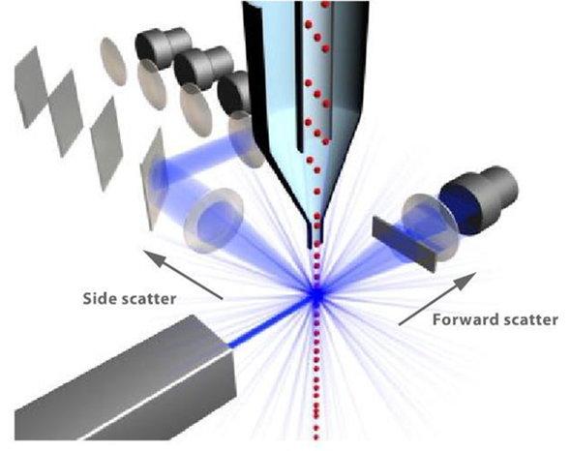
Determination of a Physicochemical Mechanism of Protocellular Membrane Reproduction
Objective & Motivation
Hypothesis
A living entity must reproduce itself, and in the case of protocells that entity includes a membrane. This proposal describes experiments designed to elucidate the physicochemical mechanism of protocellular membrane reproduction. In order to develop more sophisticated synthetic protocells, we must understand this process.
Major applications: Synthetic life, origin of life, somatic gene therapy
We hypothesize that reproduction is mediated by the adsorption of DNA to the inner leaflet of the membrane bilayer, and that adsorption of DNA to the inner wall of the cell membrane results in an asymmetric domain that leads to budding and fission of a daughter vesicle.
Scientific/Technical Approach
What do you learn that is new?
Hong, B.; Qiu, F.; Zhang, H.; Yang, Y. "J. Phys. Chem. B. 2007, 111, 5837.
Lipowsky, R. J. Phys. II 1992, 2, 1825
- Encouraging membranes to spontaneously divide has been achieved recently in model protocells; however, the mechanism of membrane reproduction is not currently known.
- It is now believed that the interaction of the genetic material with the membrane plays a crucial role in protocell reproduction, since division rate increases with increased concentration of genetic material. We will probe this hypothesis directly.
Kurihara, K., et al. Nature Chem. 2011, 3, 775.
Fluorescence
Chromatography
Flow cytometry

Slide 3
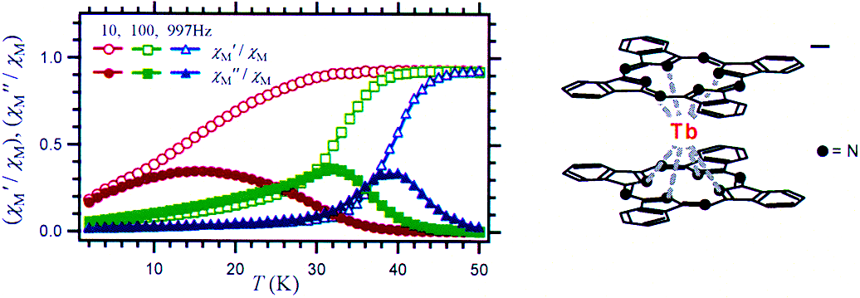
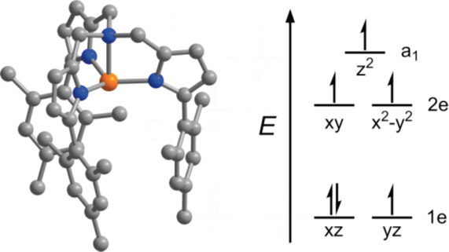
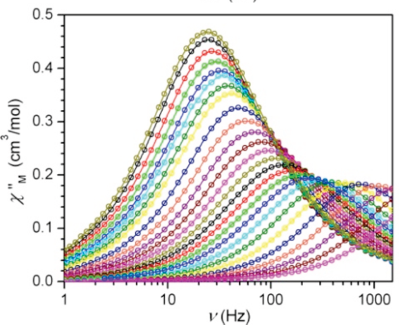
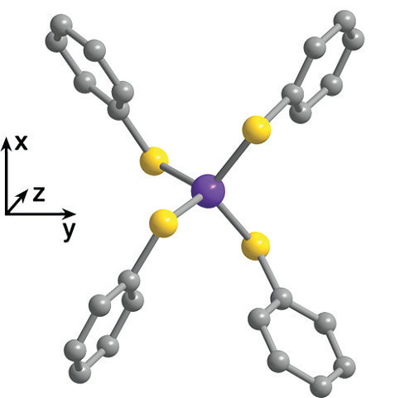
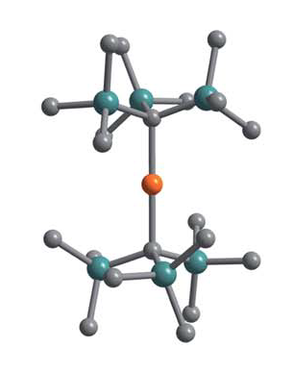
Slow Magnetic Relaxation in Mononuclear Transition Metal Complexes
Objective & Motivation
Hypothesis
- Molecules displaying slow magnetic relaxation have potential applications ranging from increased data storage capability to quantum computation.
- Beyond their practical applications, molecular magnets offer the potential for a fundamental investigation of magnetic anisotropy which may inform future synthetic efforts in to the construction of permanent magnets and other magnetic materials.
The correct ligand environment can engender an orbital contribution similar to lanthanides, and thus allow for the creation of transition metal mononuclear single-molecule magnets
Scientific/Technical Approach
What do you learn that is new?
Find and measure known compounds with the correct ligand field environment
Below: example of a published molecule and ac susceptibility data
Precise control over magnetic properties through tuning the ligand environment. This can be extended to different ligand platforms to study the specific magnetic effects of changing the electronic structure of a transition metal. See below literature molecules for future study
Notes:
Please include references on the back of the slide. References should include all author’s names and the title of the paper. This will enable the reviewer (faculty member) to determine the relevance of the paper to the experiment. For example, a paper with Prof. Ratner as the only PI is unlikely to be an experimental paper and should not be cited as previous experimental results.

